Slide 1

Understanding the Software Development Life Cycle (SDLC) Through the Analogy of Planning and Going on a Vacation
Exploring SDLC stages through vacation planning
Notes:
AI-generated content may be incorrect. --- The Software Development Life Cycle (SDLC) can be better understood through the analogy of planning and going on a vacation. This presentation will explore how each stage of SDLC parallels the steps we take when organizing a trip, providing a relatable way to grasp the concepts. Image source: Microsoft 365 content library

Slide 2

Agenda Overview
Requirements Gathering
Requirement Analysis
Sharing with Design Team
Impact Analysis
High-Level Design (HLD)
Low-Level Design (LLD)
Technical Refinement
Breakdown of Requirements
Estimation & Planning
Development (Execution)
Unit Testing
Functional Testing
Regression Testing
Notes:
--- We will cover the various stages of the SDLC, comparing them to vacation planning. From gathering requirements to functional testing, each step will reveal important insights into both software development and effective trip organization. Image source: Microsoft 365 content library

Slide 3
Requirements Gathering
Notes:
The first step in both vacation planning and SDLC is gathering requirements. This involves understanding what is desired and necessary for a successful trip or project.

Slide 4

Identifying Vacation Preferences: Beach, Mountains, Adventure, Relaxation
Understanding User Preferences
Identifying vacation preferences is essential to ensure the planning process aligns with individual desires for leisure and exploration.
Beach Vacations
A beach vacation is perfect for those seeking relaxation, sun, and water activities, creating a refreshing escape.
Mountain Adventures
Mountain vacations appeal to adventure seekers, offering hiking, climbing, and breathtaking views for an exhilarating experience.
Adventurous Activities
For those craving excitement, adventure vacations include activities like zip-lining, rafting, and wildlife safaris.
Notes:
--- Just as in software development, where requirements must reflect user preferences, identifying vacation preferences helps set the direction for the planning process. Knowing whether to opt for a beach, mountain, or adventure vacation is crucial. Image source: Microsoft 365 content library

Slide 5

Discussing Desires and Expectations with Family or Friends
Importance of Communication
Clear communication is essential when discussing desires and expectations. It ensures everyone's voice is heard and valued.
Stakeholder Engagement
Aligning desires with family or friends mirrors stakeholder engagement in projects, ensuring all needs are addressed.
Consideration of Needs
Considering each person's needs fosters a supportive environment and strengthens relationships within the group.
Notes:
--- Aligning desires and expectations with family or friends is similar to engaging stakeholders in a project. Clear communication helps ensure that everyone's needs are considered from the outset. Image source: Microsoft 365 content library

Slide 6
Requirement Analysis
Notes:
Once preferences are established, the next stage is requirement analysis. This includes evaluating potential options and restrictions.

Slide 7

Researching Possible Destinations and Activities
Importance of Research
Researching destinations is crucial to understanding the options available and aligning them with group needs.
Analyzing Requirements
Similar to SDLC requirements gathering, analyzing travel options ensures the best choices for the group.
Finding the Best Fit
The goal of researching options is to identify the destination that best meets the desires and needs of the group.
Notes:
--- Researching destinations parallels the analysis of requirements in SDLC. It involves exploring various options to find the best fit for the group's desires and needs. Image source: Microsoft 365 content library

Slide 8

Considering Weather, Travel Advisories, Visas, and Budget Constraints
Assessing Weather Conditions
Travelers should take the climate into account to ensure the best experience during their vacation.
Checking Travel Advisories
It's vital to review travel advisories to stay informed about safety and health concerns in the destination.
Understanding Visa Requirements
Travelers must know the visa requirements for their destination to avoid any entry issues.
Managing Budget Constraints
Establishing a budget helps travelers prioritize their expenses and make informed decisions during their trip.
Notes:
--- Just like assessing project constraints, travelers must consider practical factors like weather, travel advisories, and budget. This ensures that the chosen vacation is feasible and enjoyable. Image source: Microsoft 365 content library

Slide 9
Sharing with Design Team
Notes:
In the SDLC, sharing information with the design team is vital. For vacation planning, this could mean consulting experts to refine options.

Slide 10

Consulting with a Travel Agent or Planner
Expert Guidance
Travel agents provide expert guidance, helping clients navigate vacation options effectively and efficiently.
Informed Decisions
Just like in software design, consulting a travel agent allows for informed decision-making tailored to client preferences.
Personalized Experiences
Travel agents help create personalized travel experiences, ensuring that vacations meet unique client needs and desires.
Notes:
--- Working with a travel agent is similar to consulting with the design team in software development. Their expertise helps in making informed decisions about vacation options. Image source: Microsoft 365 content library

Slide 11

Exploring Various Vacation Options and Packages
Variety of Options
Travelers can explore a wide range of vacation options, including adventure, relaxation, and cultural experiences.
Packages for Every Budget
Vacation packages cater to different budgets, ensuring everyone can find an option that suits their financial plan.
Tailored Experiences
Many travel options allow for customization, enabling travelers to tailor their experiences to fit personal preferences.
Notes:
--- Exploring various options and packages allows travelers to see what is available, much like reviewing different design proposals in software projects. Image source: Microsoft 365 content library

Slide 12
Impact Analysis
Notes:
Impact analysis evaluates how the planned trip will affect existing commitments, mirroring the importance of assessing impact in software projects.

Slide 13

Evaluating the Trip's Impact on Work Schedules and School Breaks
Trip Alignment with Work Schedules
Evaluating how a trip fits into work schedules helps prevent conflicts and ensures participants can fully enjoy their time off.
School Break Compatibility
Aligning the trip with school breaks is essential to accommodate students and families, allowing for a stress-free vacation.
Notes:
--- Understanding how a trip aligns with work schedules and school breaks is crucial to ensure all participants can enjoy the vacation without conflicts. Image source: Microsoft 365 content library

Slide 14
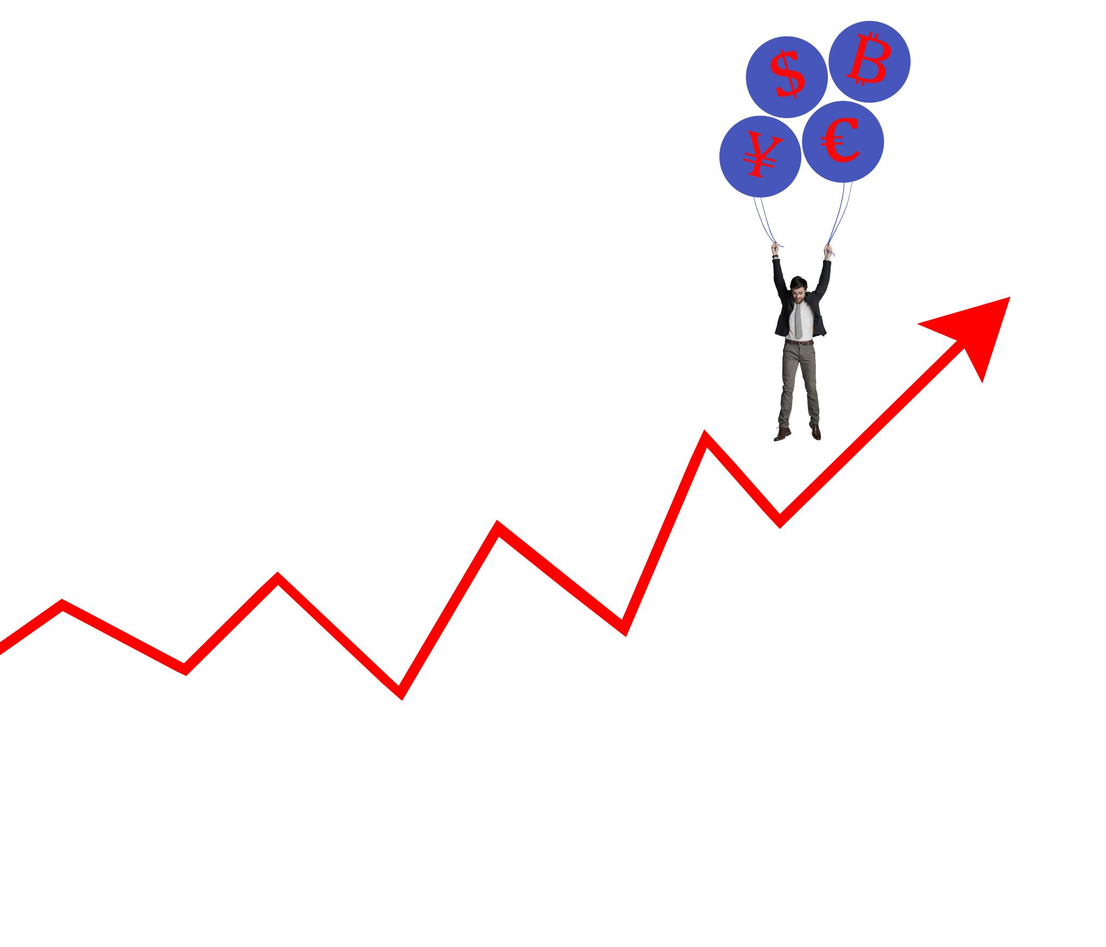
Checking Alignment with Holidays and Other Commitments
Project Timeline Alignment
Ensuring project timelines are aligned with overall business goals is crucial for project success and resource management.
Holiday Planning
Checking holiday alignment allows organizations to smoothly plan vacations and avoid scheduling conflicts.
Notes:
--- Similar to ensuring project timelines fit within overall business goals, checking holiday alignment allows for smooth vacation planning. Image source: Microsoft 365 content library

Slide 15
High-Level Design (HLD)
Notes:
The high-level design creates a framework for the trip, just like it does in SDLC. This includes major bookings and planning key aspects.

Slide 16

Creating a Rough Itinerary: Flight Bookings, Hotel Reservations, Main Attractions
Structuring the Vacation
Creating a rough itinerary provides a structured overview for planning a successful vacation.
Flight Bookings
Including flight bookings in your itinerary ensures you have all travel details in one place, making planning easier.
Hotel Reservations
Hotel reservations are essential components of your itinerary, which aid in budgeting and accommodation planning.
Main Attractions
Listing main attractions in the itinerary helps prioritize visits and maximize enjoyment during the vacation.
Notes:
--- A rough itinerary helps structure the vacation, similar to creating an overview of a software project. It sets the stage for further detailed planning. Image source: Microsoft 365 content library

Slide 17

Planning Key Aspects of the Trip
Identifying Main Attractions
Identifying main attractions is crucial for trip planning as it helps prioritize experiences that enhance the travel journey.
Core Components in Software Design
Just like core components in software design, identifying key trip aspects ensures that essential experiences are not overlooked.
Prioritizing Essential Experiences
Prioritizing essential experiences leads to a fulfilling trip, ensuring that travelers engage with what matters most during their journey.
Notes:
--- Planning key aspects, such as main attractions, aligns with identifying core components in software design. It ensures essential experiences are prioritized. Image source: Microsoft 365 content library

Slide 18
Low-Level Design (LLD)
Notes:
The low-level design breaks down the rough itinerary into detailed daily plans, akin to specifying all elements of the software systems.

Slide 19

Detailing Daily Plans: Local Transport, Meal Stops, Backup Options, Ticket Times
Local Transport Planning
Planning local transport options helps ensure timely arrivals at destinations and enhances the overall travel experience.
Meal Stops Coordination
Identifying meal stops in advance can save time and prevent unnecessary delays during the trip.
Backup Options
Having backup options in place ensures that any unexpected changes can be smoothly managed, avoiding disruptions.
Ticket Times Management
Keeping track of ticket times for attractions and transport is essential for a well-organized itinerary.
Notes:
--- Detailing daily plans ensures a smooth experience during the trip, much like specifying exact actions in software development to avoid surprises. Image source: Microsoft 365 content library

Slide 20
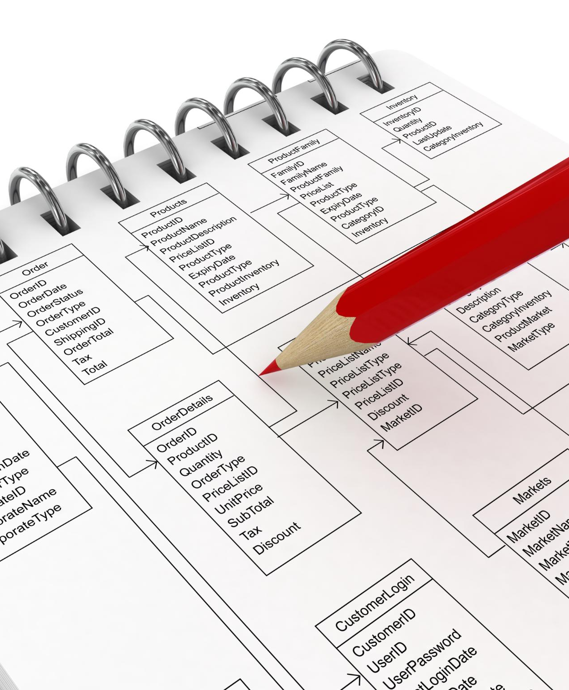
Specifying Concrete Actions and Schedules
Importance of Concrete Actions
Concrete actions provide clear steps to follow, ensuring that all necessary tasks are completed efficiently.
Role of Schedules
Schedules help in organizing time effectively, allowing participants to manage their activities and commitments during the trip.
Guiding Software Development
Just like concrete actions and schedules are crucial for trip planning, detailed specifications are vital for guiding software development processes.
Notes:
--- Concrete actions and schedules help in executing the trip effectively. This mirrors how detailed specifications guide software developers. Image source: Microsoft 365 content library

Slide 21
Technical Refinement
Notes:
Technical refinement is about fine-tuning plans to handle unforeseen events, reflecting the need for adaptability in both vacation planning and software development.

Slide 22
Mapping Out Contingency Plans: Handling Flight Delays or Weather Changes
Importance of Contingency Plans
Contingency plans are vital for travelers to navigate unexpected situations, ensuring a smoother travel experience.
Comparison to Software Development
Just like software teams prepare for potential development issues, travelers must anticipate and plan for delays.
Handling Weather Changes
Being prepared for weather changes is crucial for travelers to ensure flexibility and adaptability during their journey.
Notes:
--- Contingency plans ensure that travelers are prepared for unexpected events, just as software teams prepare for potential issues that arise during development. Image source: Microsoft 365 content library

Slide 23

Preparing for Unforeseen Events
Enhanced Vacation Experience
Preparation for unforeseen events makes vacations more enjoyable and less stressful, allowing for better experiences.
Risk Management in SDLC
Incorporating risk management into the Software Development Life Cycle ensures that teams are prepared for potential challenges.
Importance of Contingency Planning
Having a contingency plan allows individuals and teams to adapt quickly to unforeseen circumstances, minimizing disruptions.
Notes:
--- Being ready for unforeseen events enhances the vacation experience, paralleling the need for risk management in the SDLC. Image source: Microsoft 365 content library

Slide 24
Breakdown of Requirements
Notes:
Breaking down requirements involves organizing tasks for a successful trip, mirroring how software teams delegate roles and responsibilities.

Slide 25

Assigning Roles: Who Packs What, Books Rides, Handles Documents
Role Assignment Importance
Assigning roles is crucial for ensuring that all aspects of the trip are planned and executed smoothly.
Efficiency in Delegation
Much like in a software development team, proper delegation of tasks enhances efficiency and reduces stress during trip preparation.
Notes:
--- Assigning roles ensures that everything is covered for the trip, just like delegating tasks within a software development team promotes efficiency. Image source: Microsoft 365 content library

Slide 26
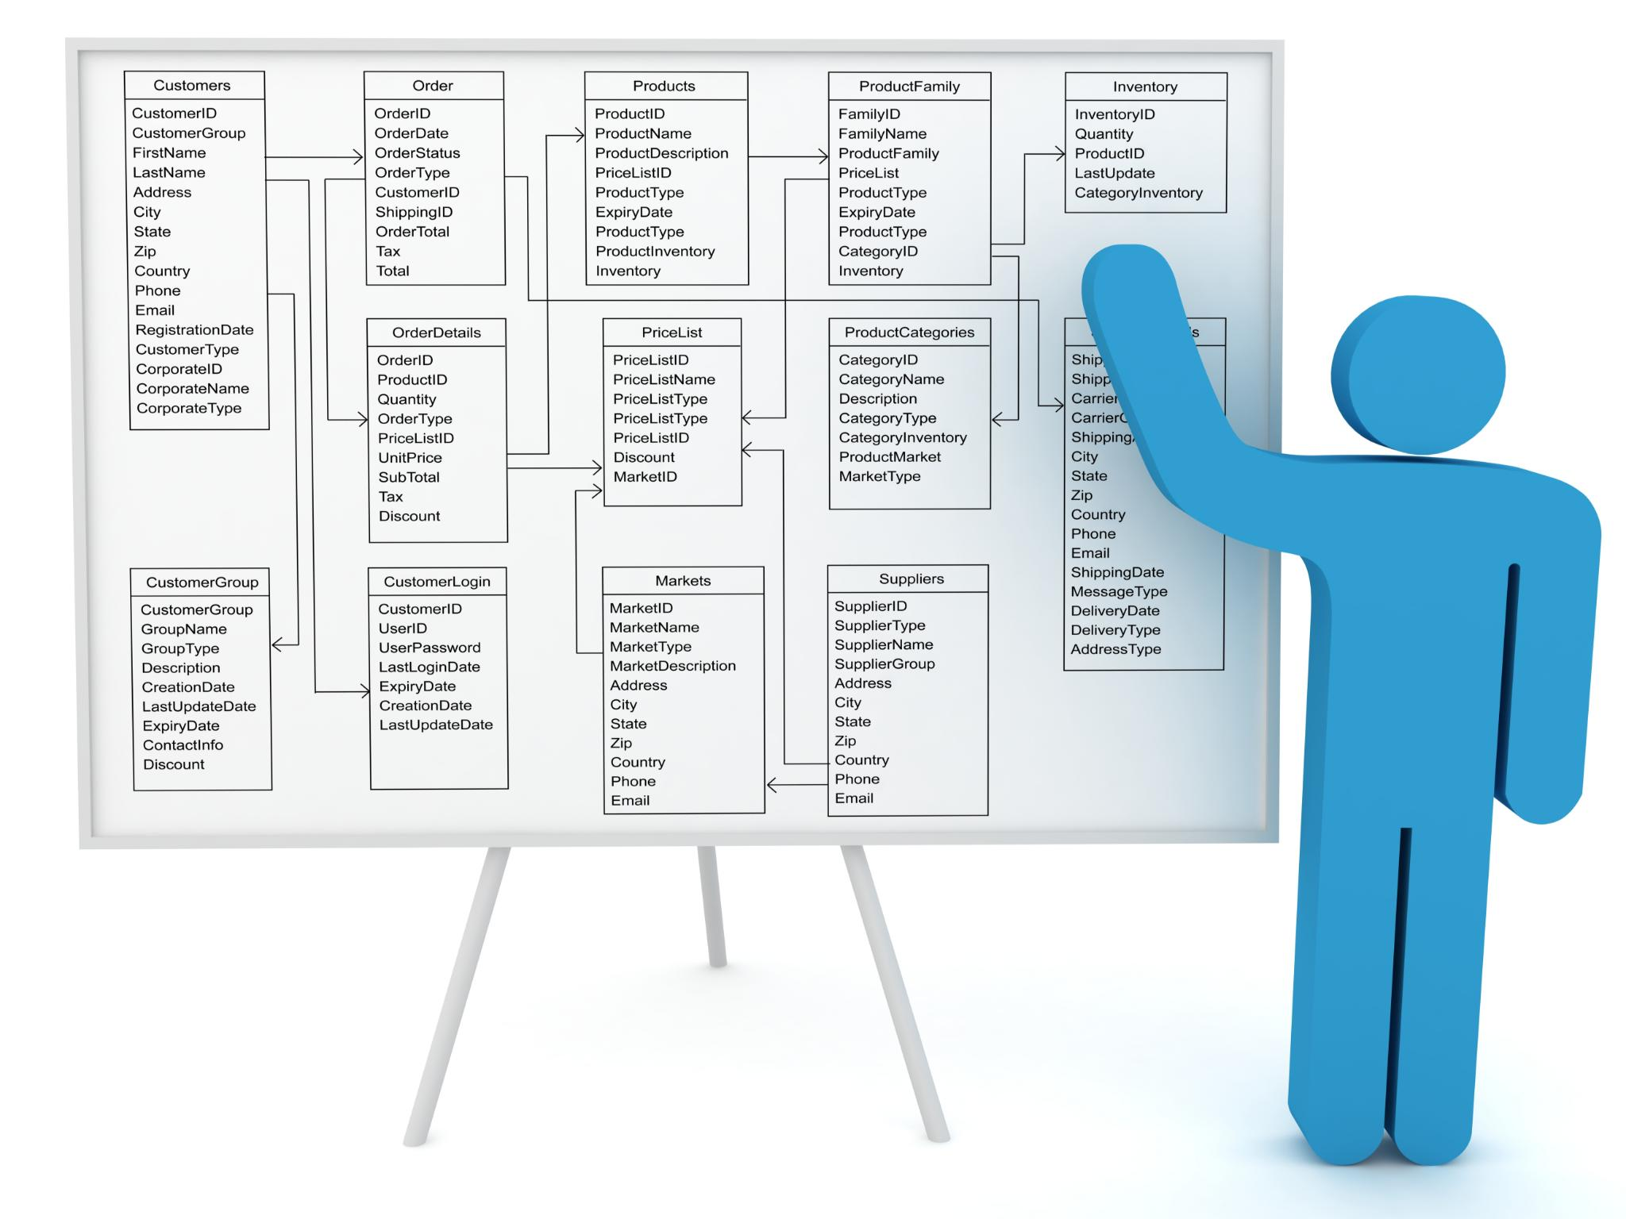
Organizing Responsibilities
Streamlined Planning Process
Organizing responsibilities is essential for creating a streamlined planning process that enhances efficiency.
Order in Project Management
Maintaining order in project management through clear responsibilities ensures that objectives are met effectively.
Notes:
--- Organizing responsibilities keeps the planning process streamlined and efficient, akin to maintaining order in project management. Image source: Microsoft 365 content library

Slide 27
Estimation & Planning
Notes:
Estimation and planning are crucial for both vacations and software development. This stage involves budgeting and scheduling for activities.

Slide 28

Estimating Time and Money Needed for Activities: Sightseeing, Shopping, Etc.
Setting Realistic Expectations
Estimating time and money allows travelers to set realistic expectations for their activities, enhancing the overall experience.
Planning Sprints in Projects
Similar to planning sprints in software projects, estimating resources aids in effectively managing travel plans.
Financial Planning for Activities
Understanding the financial aspects of activities ensures travelers stay within budget and avoid overspending.
Notes:
--- Estimating time and money helps set realistic expectations for the trip, just as it does when planning sprints or timelines in software projects. Image source: Microsoft 365 content library

Slide 29

Budgeting for the Vacation
Importance of Budgeting
Budgeting is crucial for ensuring a stress-free vacation by preventing overspending and maintaining financial control.
Financial Stress Prevention
Effective budgeting helps travelers enjoy their trips without the burden of financial stress.
Budgeting in Project Management
Similar to managing project budgets in SDLC, vacation budgeting ensures all expenses are accounted for.
Notes:
--- Budgeting is essential to prevent overspending and ensures that the trip can be enjoyed without financial stress. This is similar to managing project budgets in SDLC. Image source: Microsoft 365 content library

Slide 30
Development (Execution)
Notes:
Development is the phase where plans come to life. This is when the vacation is actually executed, following the itinerary.

Slide 31

Actually Going on the Trip: Following the Plan, Actively Participating
Execution of Development Activities
The trip is a crucial phase where development activities are executed as per the planned itinerary, ensuring goals are met.
Engaging with the Plan
Participants actively engage with the trip plan, adapting as necessary to ensure a rich and fulfilling experience.
Fulfilling Experiences
The aim of the trip is to create fulfilling experiences that enrich participants' understanding and enjoyment of the journey.
Notes:
--- The actual trip represents the execution of development activities. Participants engage with the plan, aiming for a fulfilling experience. Image source: Microsoft 365 content library

Slide 32

Executing the Vacation Itinerary
Planned Itinerary
A well-structured itinerary serves as a roadmap for a successful vacation, guiding travelers through planned activities.
Adaptability in Travel
Travel often requires flexibility, allowing travelers to adjust plans for unexpected opportunities or challenges.
Maximizing Experience
The ultimate goal of following an itinerary is to enhance the travel experience and create lasting memories.
Notes:
--- Following the planned itinerary is akin to executing a codebase. It requires adaptability while aiming for the best experience possible. Image source: Microsoft 365 content library

Slide 33
Unit Testing
Notes:
Unit testing in this analogy involves checking that the individual parts of the vacation go as planned, ensuring that each day meets expectations.

Slide 34

Checking Reservations and Plans for Each Day
Importance of Reservations
Having reservations organized ensures a smooth experience and prevents last-minute issues or cancellations.
Daily Planning
Planning each day effectively ensures that all activities and reservations align with the schedule.
Unit Testing Analogy
Just like unit testing in coding, checking each reservation ensures that every aspect functions as intended.
Notes:
--- Ensuring reservations are in order for each day mirrors the unit testing of code to verify that each component functions correctly. Image source: Microsoft 365 content library

Slide 35

Ensuring Daily Activities Go Smoothly
Smooth Daily Planning
Ensuring that daily activities are well-planned helps in maintaining a seamless experience throughout the trip.
Positive Experience
A smooth operation of daily plans contributes to a positive travel experience, similar to software functionality.
Verification Process
Just like software needs checking, daily plans require verification to ensure everything runs without a hitch.
Notes:
--- Actively ensuring that daily plans run smoothly helps maintain a positive experience throughout the trip, similar to verifying that aspects of software are functioning properly. Image source: Microsoft 365 content library

Slide 36
Functional Testing
Notes:
Functional testing evaluates the overall vacation experience, ensuring that it aligns with the initial expectations set during the planning phase.

Slide 37

Evaluating the Overall Vacation Experience
Trip Enjoyment Assessment
Evaluating trip enjoyment is key to understanding the overall success and satisfaction of the vacation experience.
Satisfaction Measurement
Measuring satisfaction can reveal insights into what worked well and what can be improved for future trips.
Functional Testing Analogy
Just as functional testing evaluates software products, trip assessments ensure experiences meet expectations.
Notes:
--- Assessing overall enjoyment and satisfaction helps gauge the success of the trip, just as functional testing helps evaluate the effectiveness of a software product. Image source: Microsoft 365 content library

Slide 38

Assessing Enjoyment and Satisfaction
Participant Feedback
Collecting feedback from participants is essential for understanding their enjoyment and satisfaction levels.
Feedback Loop Concept
The feedback loop concept in software development emphasizes continuous improvement based on user experiences and feedback.
Informing Future Improvements
Participant feedback directly informs future improvements, ensuring that the final product meets user needs and expectations.
Notes:
--- Feedback from participants about their enjoyment mirrors the feedback loop in software development, informing future improvements. Image source: Microsoft 365 content library

Slide 39
Regression Testing
Notes:
Regression testing ensures that any last-minute changes don’t disrupt the planned itinerary, reflecting the importance of maintaining software integrity.

Slide 40

Ensuring Last-Minute Additions Don’t Disrupt Existing Plans
Cautious Planning
Being cautious with last-minute changes is essential for preserving a positive vacation experience.
Integrity of Experience
Maintaining the integrity of the vacation experience can be compared to regression testing in software development.
Notes:
--- Being cautious with last-minute changes helps maintain the integrity of the vacation experience, similar to regression testing in software development. Image source: Microsoft 365 content library

Slide 41

Maintaining the Integrity of the Itinerary
Importance of Itinerary
A well-maintained itinerary is crucial for a smooth and enjoyable vacation experience, avoiding unnecessary stress.
Comparison with Software Functionality
Just like software updates require careful implementation, maintaining the itinerary ensures every detail aligns for optimal enjoyment.
Avoiding Disruptions
Keeping the itinerary intact prevents disruptions that could hinder the overall experience, allowing travelers to enjoy each destination.
Notes:
--- Keeping the itinerary intact ensures that the overall vacation remains enjoyable, akin to ensuring that software functions as intended after updates. Image source: Microsoft 365 content library

Slide 42
Conclusion
Planning Phase
Just as a vacation requires careful planning, the planning phase in SDLC sets the foundation for successful development.
Execution Phase
Execution during a vacation involves following the planned itinerary, similar to implementing the design during the SDLC.
Evaluation Phase
Evaluating a vacation experience is like assessing the project outcome in SDLC, ensuring improvements for future projects.
Notes:
The analogy of vacation planning offers a unique perspective on the Software Development Life Cycle. Each stage of SDLC can be understood through the steps taken in organizing a trip, highlighting the importance of planning, execution, and evaluation in both contexts.

